Slide 1
Career Exploration Plan #1B:
Clusters & Sectors

Slide 2
REMEMBER OUR GOAL

Slide 3
FOUR STAGES OF CAREER DEVELOPMENT
Career Awareness
Career Exploration & Self-Discovery
Career Management
Career Preparation & Immersion
Let’s unpack each stage, one-at-a-time….

Slide 4
CAREER CLUSTERS: WHAT Work You Do
Notes:
Let’s discuss Career Connected Learning a bit more in-depth.

Slide 5
CAREER CLUSTERS
Types of work or jobs have been identified in a different model called the Career Clusters (see the graphic above). This model focuses on how types of jobs are organized. These Clusters are not the same as the Industry Sectors. They are two different ways of looking at the world – one by the the work that you do and one by the context in which you do that work.

Slide 6
16 CAREER CLUSTERS
(1) The production, processing, marketing, distribution, financing, and development of agricultural commodities and resources including food, fiber, wood products, natural resources, horticulture, and other plant and animal products/resources.
(2) Careers in designing, planning, managing, building and maintaining the built environment.
(3) Designing, producing, exhibiting, performing, writing, and publishing multimedia content including visual and performing arts and design, journalism, and entertainment services.

Slide 7
16 CAREER CLUSTERS, CONT’D
(4) Planning, organizing, directing and evaluating business functions essential to efficient and productive business operations. Business Management and Administration career opportunities are available in every sector of the economy.
(5) Planning, managing and providing education and training services, and related learning support services.
(6) Planning, services for financial and investment planning, banking, insurance, and business financial management.

Slide 8
16 CAREER CLUSTERS, CONT’D
(7) Executing governmental functions to include governance; national security; foreign service; planning; revenue and taxation; regulation; and management and administration at the local, state, and federal levels.
(8) Planning, managing, and providing therapeutic services, diagnostic services, health informatics, support services, and biotechnology research and development.
(9) Management, marketing and operations of restaurants and other food services, lodging, attractions, recreation events, and travel related services.

Slide 9
16 CAREER CLUSTERS, CONT’D
(10) Careers that relate to families and human needs. Some examples might be barbers, childcare workers, counselors, funeral service directors, and nail technicians.
(11) Design, development, support and management of hardware, software, multimedia, and systems integration services.
(12) Planning, managing, and providing legal, public safety, protective services and homeland security, including professional and technical support services.

Slide 10
16 CAREER CLUSTERS, CONT’D
(13) Planning, managing and performing the processing of materials into intermediate or final products and related professional and technical support activities such as production planning and control, maintenance, and manufacturing/process engineering.
(14) Planning, managing, and performing marketing activities to reach organizational objectives. Public relations executives fall into this Career Cluster.
(15) Planning, managing, and providing scientific research and professional and technical services (e.g., physical science, social science, engineering) including laboratory and testing services, and research and development services.
(16) Planning, management, and movement of people, materials, and goods by road, pipeline, air, rail, and water and related professional and technical support services such as transportation infrastructure planning and management, logistics services, mobile equipment, and facility maintenance.

Slide 11
INDUSTRY SECTORS: WHERE You Do Your Work
Notes:
Let’s discuss Career Connected Learning a bit more in-depth.

Slide 12
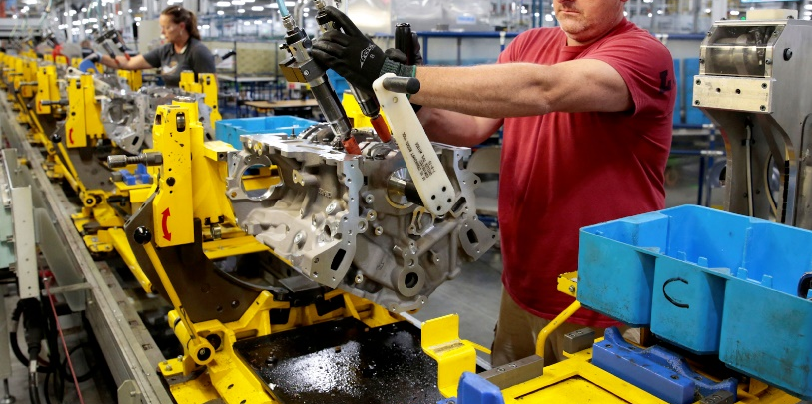
GOODS-PRODUCING INDUSTRY SECTORS
(A) Natural Resources and Mining
Agriculture, Forestry, Fishing, and Hunting
Mining, Quarrying, and Oil and Gas Extraction
(B) Manufacturing
Manufacturing
(C) Construction
Construction

Slide 13
SERVICE-PROVIDING INDUSTRY SECTORS
(D) Trade, Transportation, and Utilities
Wholesale Trade
Retail Trade
Transportation and Warehousing
Utilities
(E) Information
Information
(F) Financial Activities
Finance and Insurance
Real Estate and Rental and Leasing

Slide 14
SERVICE-PROVIDING INDUSTRY SECTORS, CONT’D
(G) Professional and Business Services
Professional, Scientific, and Technical Services
Management of Companies and Enterprises
Administrative and Support
Waste Management and Remediation Services
(H) Education and Health Services
Educational Services
Health Care and Social Assistance
(I) Leisure and Hospitality
Arts, Entertainment, and Recreation
Accommodation and Food Services
(J) Other Services (except Public Administration)
Other Services (except Public Administration)

Slide 15
CLUSTERS & SECTORS
Many Career Clusters support more than one Industry Sector. There is not a one-to-one correlation between each Career Cluster and each Industry Sector.
For instance, information technology workers are needed in every Industry Sector, because every industry uses computers, computer programming, and internet-based applications. Some examples:

Slide 16
CLUSTERS & SECTORS, CONT’D
Similarly, automotive technicians can work in an Industry Sectors such as retail trade (selling automotive repair services to individuals), but automotive technicians can also work directly for state and local governments maintaining their fleets of cars and trucks.

Slide 17
CLUSTERS & SECTORS, CONT’D
A scientist (from the STEM Career Cluster) might conduct research to find cures for diseases in the Health Care Industry Sector or create advanced materials for the Manufacturing Industry Sector.

Slide 18
CLUSTERS & SECTORS, CONT’D
Also, while there is a group of businesses known as the “Financial Services Industry Sector” (including banks, investment firms, insurance), people who have financial expertise like accountants and bookkeepers are employed in EVERY Industry Sector.

Slide 19
THE WORLD OF WORK
Your Career Cluster is WHAT YOU DO
Your Industry Sector is WHERE YOU DO IT

Slide 20
NOW IT’S TIME TO SHOW WHAT YOU KNOW!

Slide 21
A Professional Learning Program Helping Instructors and Their Students Get Smarter About Career Connections

