Slide 1
Career Exploration Plan #1A:
Getting Started On Your Career Journey

Slide 2
UNIT OVERVIEW
Reading
What is Career Development?
World of Work: Career Clusters & Industry Sectors
Activity
My Favorite Career Clusters
My Favorite Industry Sectors
Assess
Show What You Know

Slide 3
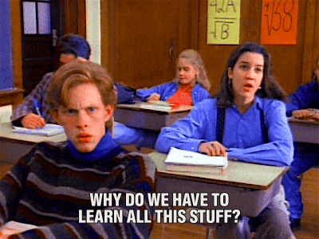
HAVE YOU EVER ASKED…

Slide 4
WHAT DO YOU WANT TO BE WHEN YOU GROW UP?
Non-college jobs? Fine for others… but not for me!
YIKES!
I’ll think about this later!
I really want a good job…
…and a career that I’m proud of!
Just graduating from high school is good enough…
MAN, this is a tough question to answer!

Slide 5
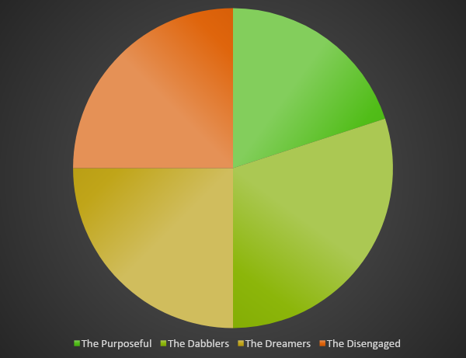
MANY WITHOUT A PURPOSE
The Disengaged:
Neither a purpose in life nor an inclination to find one
The Purposeful:
Found something meaningful, sustained interest, and a clear sense of future purpose
The Dreamers: Imagining great things, no practical pursuits
The Dabblers: Tried potentially purposeful pursuits, yet to commit
Paths To Purpose (William Damon)
Sparks… (Peter Benson)
www.searchinstitute.org

Slide 6
WHY SO MANY…
…bright youth, drifting out of college?
…bright youth, working, but underemployed?
…disconnected youth, stuck in low-skilled or no job?
…FAIL TO LAUNCH!

Slide 7
THE MISSING INGREDIENT
CAREER CONNECTED LEARNING
Notes:
Let’s discuss Career Connected Learning a bit more in-depth.

Slide 8
WHAT IS CAREER DEVELOPMENT?
Career Development is:
Personal Discovery
Learning about Careers
Trying out Career Interests
Helping young people make informed choices about careers and related post-secondary education and training.

Slide 9
WHAT DO YOU WANT TO DO WHEN YOU GROW UP?
Let’s start with a positive career mindset….
The process of career exploration and education is like a puzzle.
No one can truly make out a clear picture with too few pieces in place!
Many pieces, sometimes turned on their side or upside down until they fit, can help you to create a clear picture of your future career.

Slide 10
WHAT DO YOU WANT TO DO WHEN YOU GROW UP? (cont’d)
Sometimes this process can be frustrating, but…
Try to see this process as an exciting opportunity for discovery!
It also gives you the chance to partner with others!
With some practice and some patience, your career picture can become crystal clear.

Slide 11
MAKING SENSE OUT OF THE CONFUSION
Interests, Aptitudes, Values, Options, Decisions…
Four Stages of Career Development
VS.

Slide 12
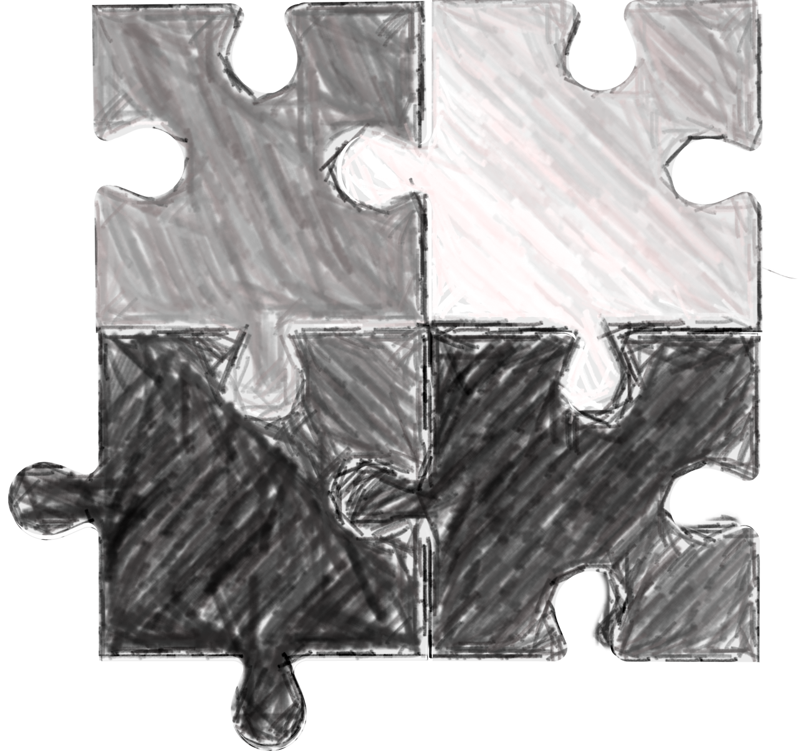
FOUR STAGES OF CAREER DEVELOPMENT
Career Awareness
Career Exploration & Self-Discovery
Career Management
Career Preparation & Immersion
Let’s unpack each stage, one-at-a-time….

Slide 13
IT’S SORT OF LIKE A PUZZLE…
Sometimes we need to try different angles to get just the right fit.
Sometimes we need to reflect and re-evaluate.
And sometimes we need help!

Slide 14
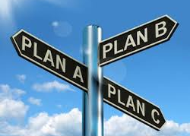
NO MAGICAL CAREERS!
We discourage the “magical career” mindset.
Instead, we promote
Plan A…
Plan B…
and Plan C…
with success in every direction!

Slide 15
THE WORLD OF WORK
Career Connected Learning helps you connect learning to the real world and develop the knowledge, skills, and mindset to successfully enter the adult world of work, careers, and community life.

Slide 16
NOW IT’S TIME TO SHOW WHAT YOU KNOW!

Slide 17
A Professional Learning Program Helping Instructors and Their Students Get Smarter About Career Connections

